Slide 1
A Pattern-Based Approach for Sarcasm Detection on Twitter
MONDHER BOUAZIZI AND TOMOAKI OTSUKI (OHTSUKI), (Senior Member, IEEE)

Slide 2
Introduction
Value of this task
Due to the informal language used in Twitter and the limitation in terms of characters, understanding the opinions of users and performing such analysis is quite difficult.
Furthermore, presence of sarcasm makes the task even more challenging: sarcasm is when a person says something different from what he means.
Maynard and Greenwood show that sentiment analysis performance might be highly enhanced when sarcasm within the sarcastic statements is identified. Therefore, the need for an efficient way to detect sarcasm arises.

Slide 3
Introduction
Definition
The online Oxford dictionary defines sarcasm as
``the use of irony to make or convey contempt'’
Collins dictionary defines it as
``mocking, contemptuous, or ironic language intended to convey scorn or insult’
The Free Dictionary also defines sarcasm as
``a form of irony that is intended to express contempt. ``
Sarcasm and irony have been studied as two close and very correlated concepts or even as the same one

Slide 4
Introduction
Contribution
identify the main purposes for which sarcasm is used in social networks
propose an efficient way to detect sarcastic tweets, and study how to use this information (i.e., whether the tweet is sarcastic or not) to enhance the accuracy of sentiment analysis
study the added value of the different sets of features used, in particular, in terms of precision of detection

Slide 5
Related Work
In general, we can classify the related work into 3 categories:
Rule-based approaches
such as the work of Maynard and Greenwood [11] and that of Ghosh et al. [31]
Semi-supervised approaches
such as the works proposed by Tsur et al. [8], that proposed by Davidov et al. [9] and that proposed by Bharti et al. [36]
Supervised approaches
such as the work of Muresan et al. [34], that of Wang et al. [32] and that of Rajadesingan et al. [12].

Slide 6
Related Work
As for the features used in the supervised approaches they fall into 3 sets:
n-gram-based features , which have been used along with other features in the majority of the works
such as the works of Barbieri et al. [30], Riloff et al. [33] and that of Ghosh et al. [31],
Sentiment-based features
such as the works of Reyes et al. [37], [38] and Joshi et al. [39],
Saracstic pattern-based features
such as the works of Tsur et al. [8], Davidov et al. [9] and Riloff et al. [33], etc.
Other works added the contextual features to enhance the classification
the historical context as in [12]
the conversation context as in [39] and [40]
the topical context as in [32]

Slide 7
Problem
Given a set of tweets,
we aim to classify each one of them depending on whether it is sarcastic or not.

Slide 8
Data
Twitter
December 2014 to March 2015
queried Twitter's streaming API for tweets containing the hashtag ``#sarcasm'’
Liebrecht et al. [10] concluded in their work that this hashtag is not the best way to collect sarcastic tweets, other works such as [9] highlighted the fact that this hashtag can be used for this purpose
the hashtag ``#sarcasm'’ was used mainly for 3 purposes
to serve as a search anchor
to serve as a sarcasm marker in case of a very subtle sarcasm where it is very hard to get the sarcasm without an explicit marker, as in ``Today was fun. The first time since weeks! #Sarcasm’’
to clarify the presence of sarcasm in a previous tweet, as in ``I forgot to add #sarcasm so people like you get it!’’.
collected 58 609 tweets with the hashtag ``#sarcasm'', which we cleaned up by removing the noisy and irrelevant ones

Slide 9
Data
Set 1 (Training Set)
3000 sarcastic tweets, and 3000 non-sarcastic one
manually classified depending on their level of sarcasm
from 1 (highly non-sarcastic) to 6 (highly sarcastic)
The hashtag ''#sarcasm'’ has not been removed yet when the annotation is done
Set 2 (Optimization Set)
1128 sarcastic tweets, and 1128 non-sarcastic one
Sarcastic tweets are collected by querying Twitter API; no manual check is done
the non-english tweets, very short tweets (i.e., that have less than 3 words), and those which contain URLs are filtered out
Set 3 (Test Set)
500 sarcastic tweets, and 500 non-sarcastic ones
All tweets are manually checked
In addition, during our work, we removed the hashtag ``#sarcasm'' from all the tweets.

Slide 10
Tools
Feature Extraction
Apache OpenNLP
Tokenization
Lemmatization
Etc.
Twitter part-of-speech tagger [41]
POS
Classification
Weka[42]
A variety of classifiers
Libsvm
SVM

Slide 11
Data Insight
The annotators concluded that sarcasm is used for different purposes, which fall mostly in three categories:
Sarcasm as wit
used with the purpose of being funny; the person employs some special forms of speeches, tends to exaggerate, or uses a tone that is different from that when he talks usually to make it easy to recognize
capital letter words, exclamation and question marks, as well as some sarcasm-related emoticons.
Sarcasm as whimper
show how annoyed or angry the person is
tempt to show how bad the situation is by using exaggeration or by employing very positive expressions to describe a negative situation.
Sarcasm as evasion
avoid giving a clear answer
employs complicated sentences, uncommon words and some unusual expressions.

Slide 12
Sentiment-related Features
Explanation
an emotionally positive expression is used in a negative context
Riloff et al. [33] show that this type of sarcasm can be identified and detected when a positive statement, usually a verb or a phrasal verb, is collocated with a negative situation
Approach
maintain two lists of words qualified as ``positive words’’ and ``negative words’’ using SentiStrength database.
two features we denote respectively pw and nw by counting the number of positive and negative words in the tweet.

Slide 13
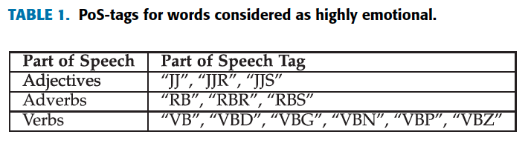
Sentiment-related Features
Adjectives, verbs and adverbs have higher emotional content than nouns [45]
two more features that we denote PW and NW
which represent the number of highly emotional positive words and highly emotional negative words (have the associated PoS-tag, shown in TABLE 1).

Slide 14
Sentiment-related Features
count the number of positive, negative and sarcastic emoticons.
Sarcastic emoticons are emoticons used sometimes with sarcastic or ironical statements (e.g., ``:P'' ).
count the number of positive and negative hashtags.
``Thank you very much for being there for me #ihateyou``

Slide 15

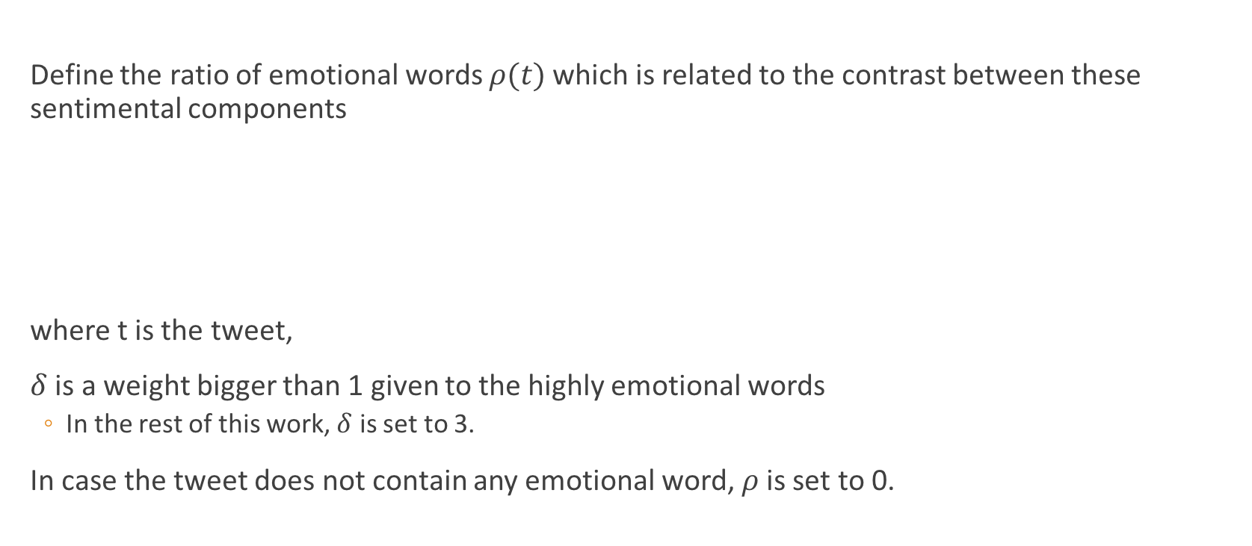
Sentiment-related Features
Define the ratio of emotional words $ρ(t)$which is related to the contrast between these sentimental components
where t is the tweet,
$δ$ is a weight bigger than 1 given to the highly emotional words
In the rest of this work, $δ$ is set to 3.
In case the tweet does not contain any emotional word, $ρ$ is set to 0.

Slide 16
Sentiment-related Features
4 features that represent whether there is a contrast between the different components (the coexistence of a negative component and a positive one within the same tweet)
between words
between hashtags
between words and hashtags
between words and emoticons

Slide 17
Punctuation-related Features
Number of exclamation marks
Number of question marks
Number of dots
Number of all-capital words
Number of quotes
whether any of the words contains a vowel that is repeated more than twice
e.g., ``looooove'’
number of words in the tweet
The ``excessive'' use of exclamation marks or question marks, or the repetition of a vowel, particularly in an emotional word, might reflect a certain tone that the user intends to show, however, this tone is not always sarcastic
``Thank you @laur3en, it was amazing !!!'’
``Thanks for another amazing day with your amazing boyfriend!!!!''

Slide 18
Syntactic and Semantic Features
People tend to make complicated sentences or use uncommon words to make it ambiguous to the listener/reader to get a clear answer
Use of uncommon words
Number of uncommon words
Number of interjections
Number of laughing expressions
Existence of common sarcastic expressions
used a noisy set of 3000 tweets having the hashtag ``#sarcasm'’
extracted all possible patterns of length varying from 3 to 6
selected the patterns that appeared more than 10 times
manually checked the list and removed the irrelevant ones
a list of 13 main patterns including
[love PRONOUN when] (e.g., ``I love it when I am called at 4 a.m. because my neighbour's kid can't sleep!'' )
[PRONOUN be ADVERB funny] (e.g., ``You are incredibly funny -_-'' )

Slide 19
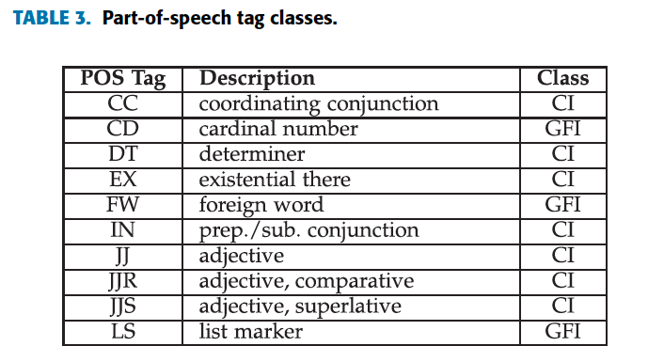
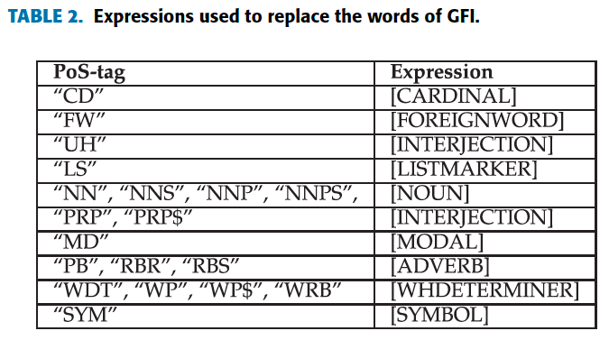
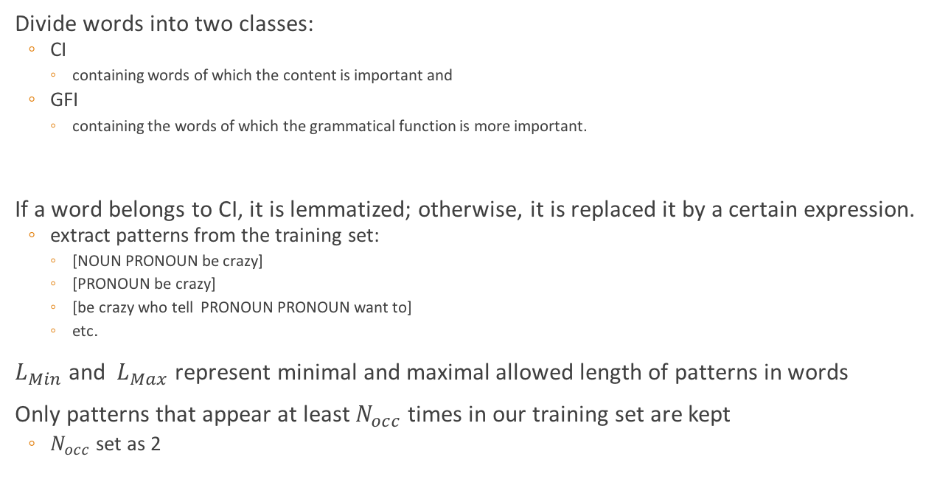
Pattern-related Features
Divide words into two classes:
CI
containing words of which the content is important and
GFI
containing the words of which the grammatical function is more important.
If a word belongs to CI, it is lemmatized; otherwise, it is replaced it by a certain expression.
extract patterns from the training set:
[NOUN PRONOUN be crazy]
[PRONOUN be crazy]
[be crazy who tell PRONOUN PRONOUN want to]
etc.
$L_{Min}$ and $L_{Max}$ represent minimal and maximal allowed length of patterns in words
Only patterns that appear at least $N_{occ}$ times in our training set are kept
$N_{occ}$ set as 2

Slide 20
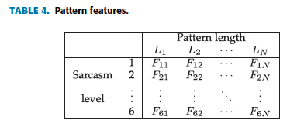
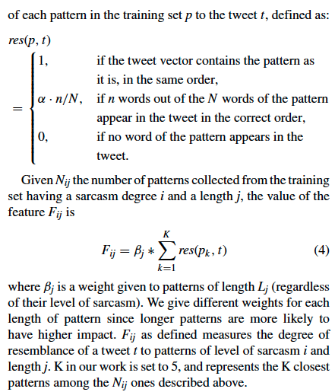
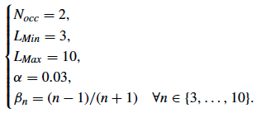

Pattern-related Features
Given a tweet t, we create $N_{F}=N_{L}×N_{S}$ features
Extension of the training set patterns:
18 959 tweets containing the hashtag ``#sarcasm'’
18 959 tweets that do not

Slide 21
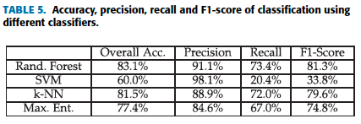
Experiment Results
Key Performance Indicators (KPIs)
Accuracy
Precision
Recall
Classification
Random Forest
SVM
k-NN
Maximum Entropy
During the preliminary experiments (i.e., parameters optimization) as well as for the rest of our analysis, the results used are those returned by the classier Random Forest.

Slide 22
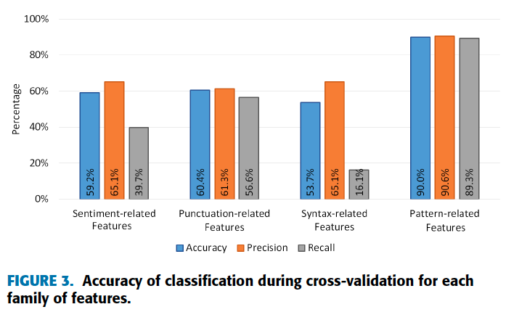
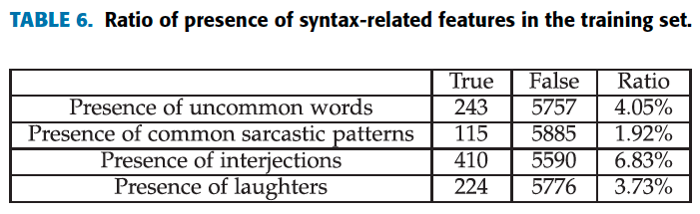
Experiment Results
A. PERFORMANCES OF EACH SET OF FEATURES
1) DURING CROSS-VALIDATION
Low presence of syntax-related features in the data set
Due to the informal language used in Twitter and the noise it has, the PoS-tagger performances are lower than when applied to a formal text. In particular, the PoS-tagger is not very efficient to detect interjections

Slide 23
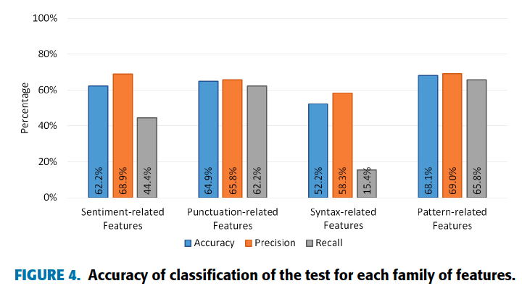
Experiment Results
A. PERFORMANCES OF EACH SET OF FEATURES
2) ON A TEST SET

Slide 24
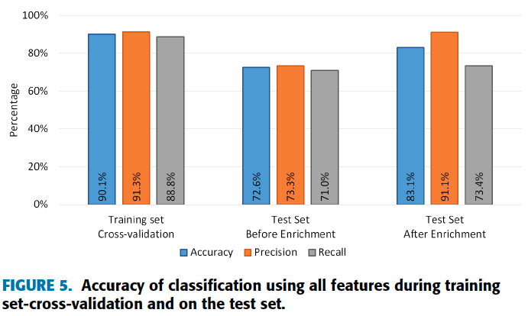
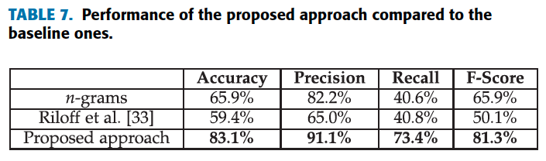
Experiment Results
B. OVERALL PERFORMANCES OF THE PROPOSED APPROACH

Slide 25
Conclusion
The approach has shown good results
might have even better results if we use a bigger training set since the patterns we extracted from the current one might not cover all possible sarcastic patterns
Proposed an efficient way to enrich our set with more sarcastic patterns using an initial training set of 6000 Tweets, and the hashtag ``#sarcasm'’
Will study how to use the output of the current one to enhance the performances of sentiment analysis and opinion mining

Slide 26
Reference
Bouazizi, M., & Ohtsuki, T. O. (2016). A pattern-based approach for sarcasm detection on twitter. IEEE Access, 4, 5477-5488.

